Slide 1

Embedding Sustainability in the Curriculum in TU Dublin through Policy and Innovative Teaching Methods
Dr Brian Gormley
Head of Sustainability Education, TU Dublin

Slide 2
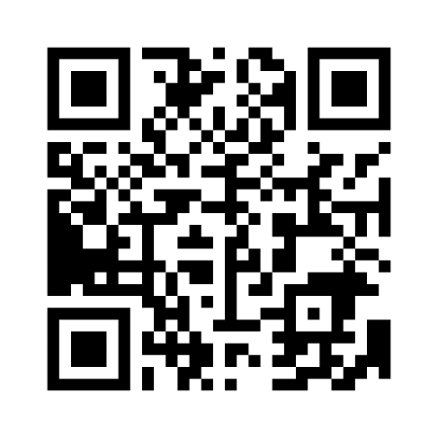
https://www.menti.com and put in code: 6544 9061

Slide 3
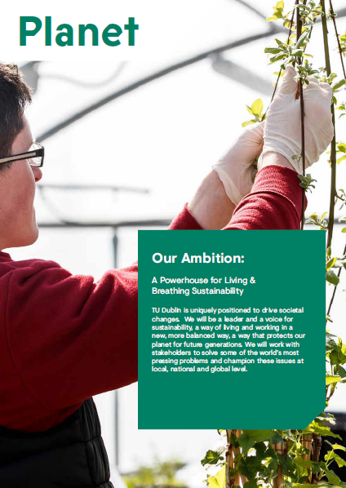
TU Dublin Strategy
Strategic Intent 2030
  All programmes will have sustainability as a learning outcome

Slide 4
In terms of weight, what percentage of mammals on earth are wild animals (e.g. Elephants, rabbits, rats, whales, etc!)

Slide 5
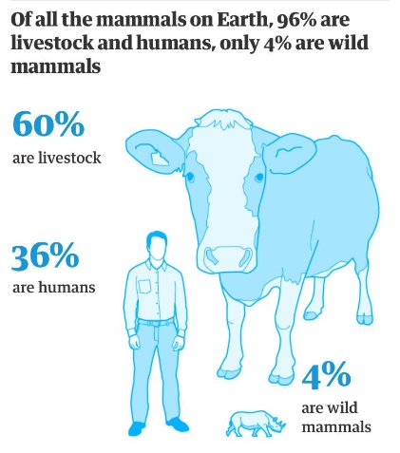

Slide 6
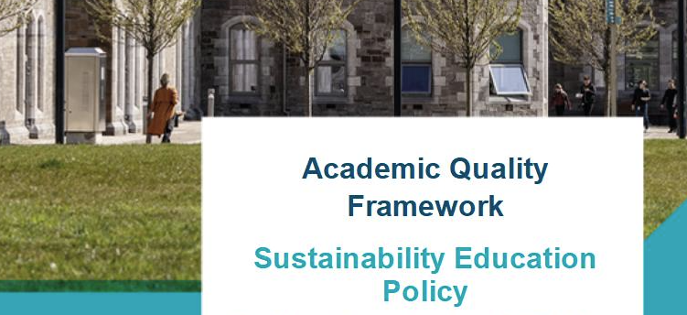
Policy and Systems
Sustainability Education Policy
  Sustainability integrated into curriculum – not a stand-alone module.
  Progressive development of skills

Slide 7

Policy and Systems
Graduate Attribute
  Based on SDGs and GreenComp
Quality Framework
  Programmatic Reviews
  Validation process
  Integration with Programme Module Catalogue

Slide 8


Education for Sustainability
Digital Badge
National Forum for the Enhancement of Teaching and Learning in Higher Education Digital Badge on ‘Education for Sustainability’, co-facilitated by ATU, TU Dublin, UCC, DCU, and SETU.
Partnership with FE sector.
https://opencourses.ie/opencourse/education-for-sustainability/

Slide 9
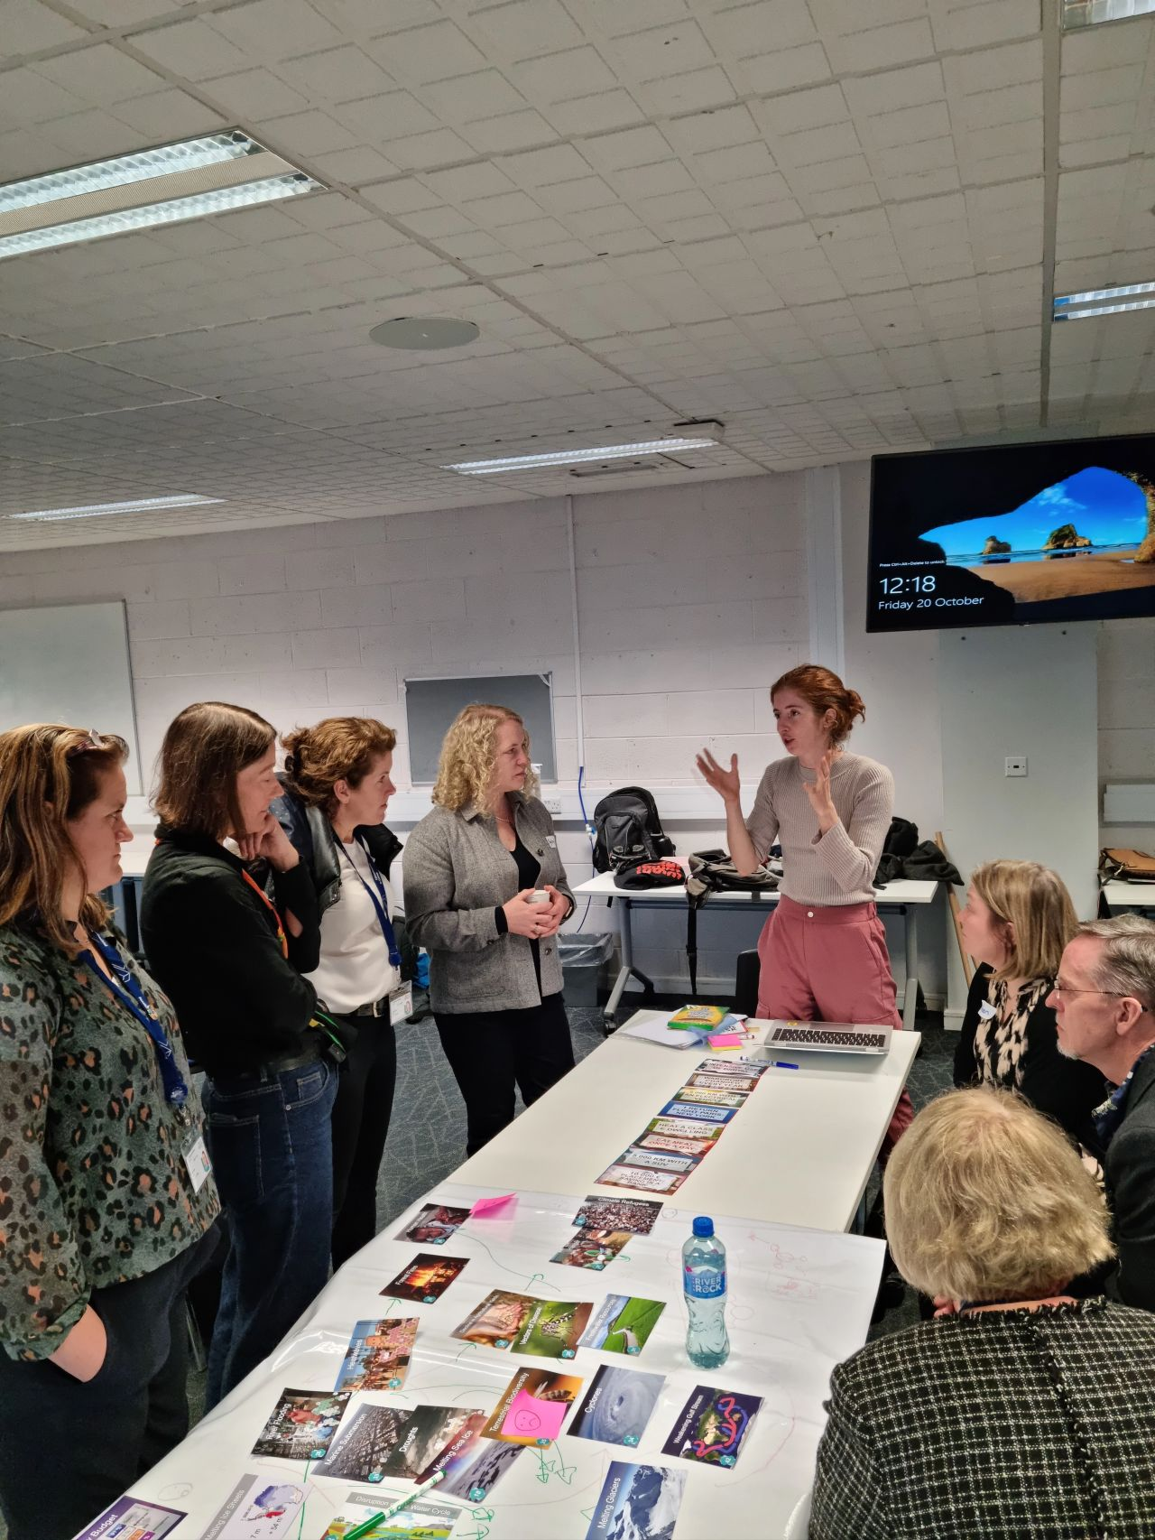
Staff capacity building
CPD – Educating for Sustainability
I thought the entire CPD was brilliant - (even the bits that confused the heck out of me) were so useful as a way of thinking about the topics. I got absolutely lost in some of the sections with family debates going on - capitalists versus environmentalists, which led to some interesting dinner table conversations.​ I started using the SDG wedding cake in almost every class & many other concepts too.

Slide 10
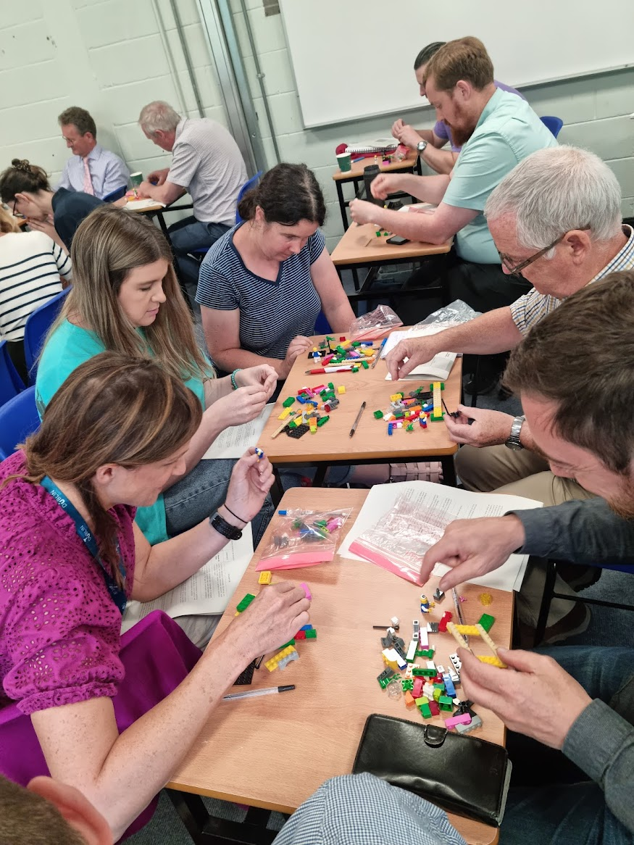
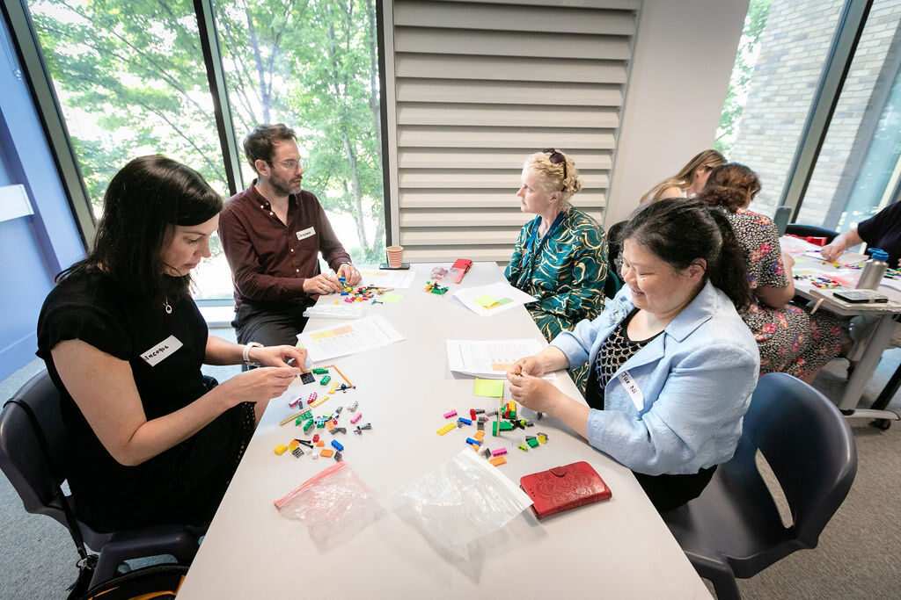
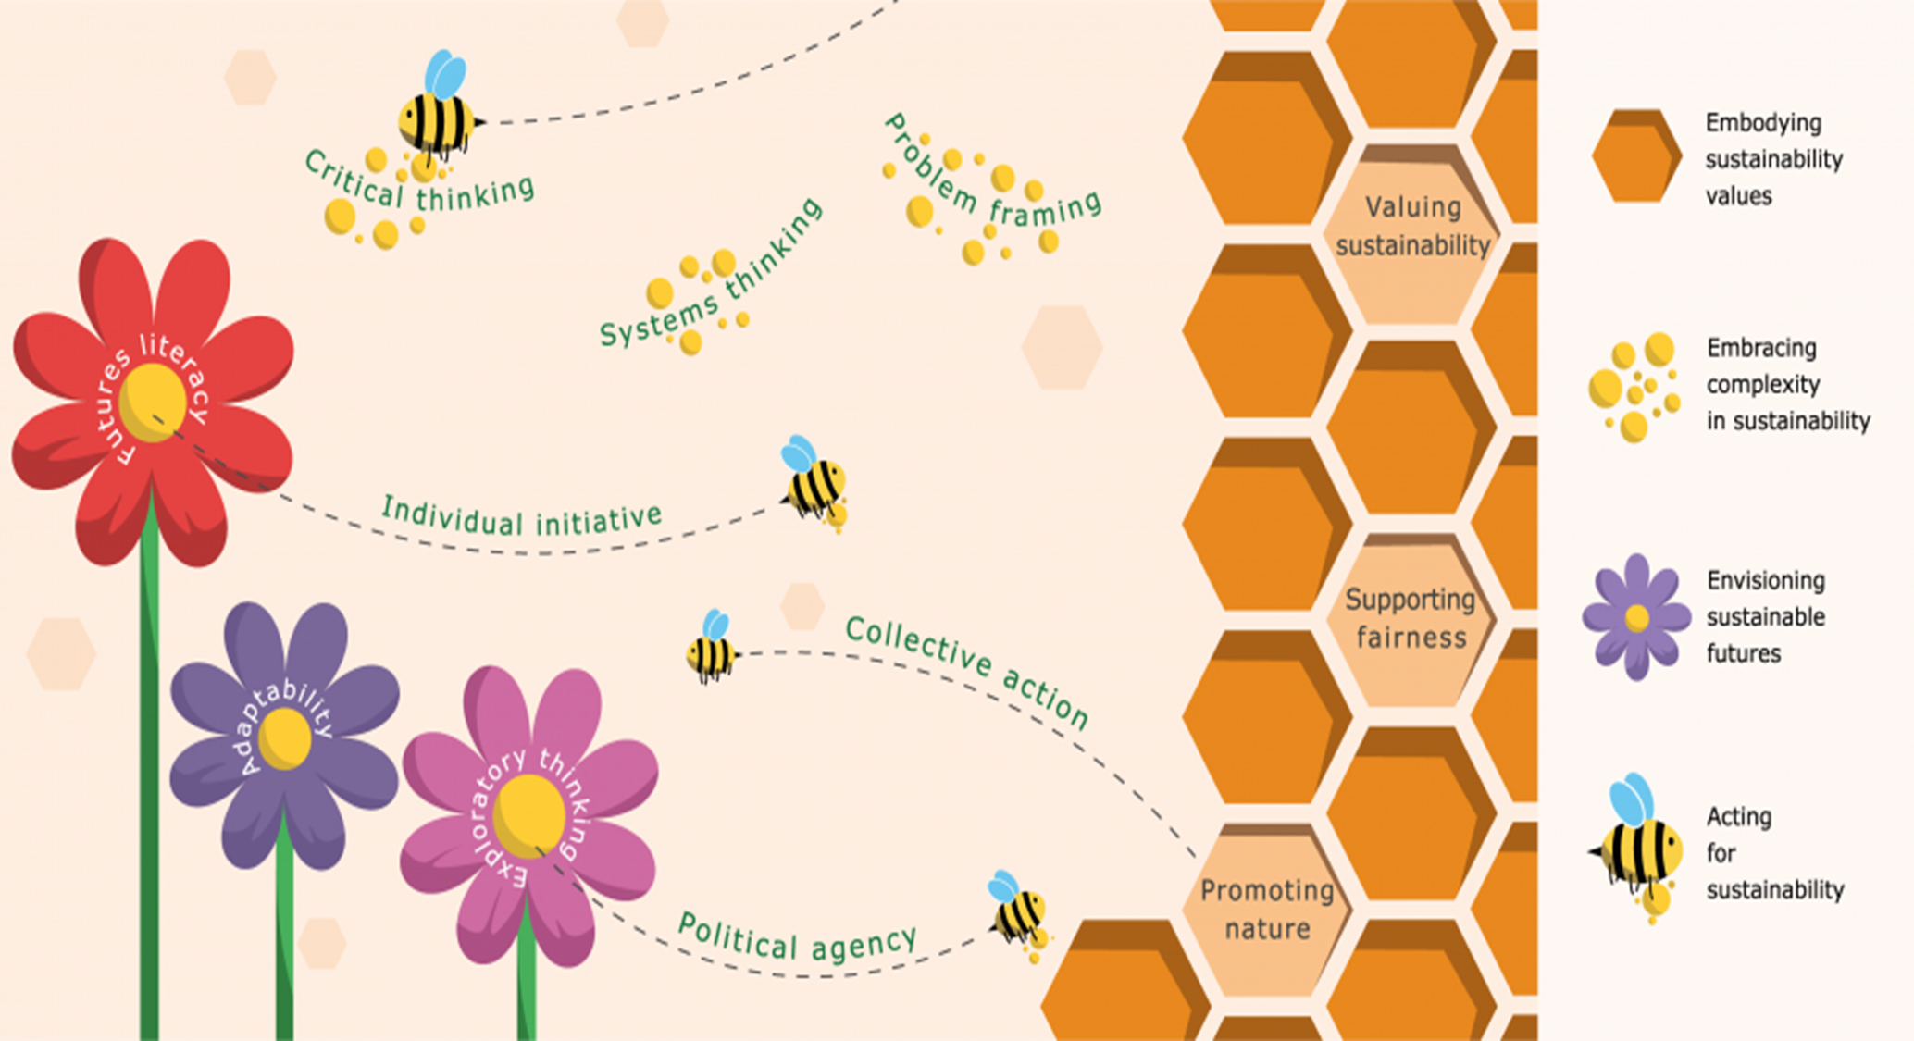
School/Discipline/Programme Team workshops
Focused on auditing and reviewing programmes and modules

Slide 11
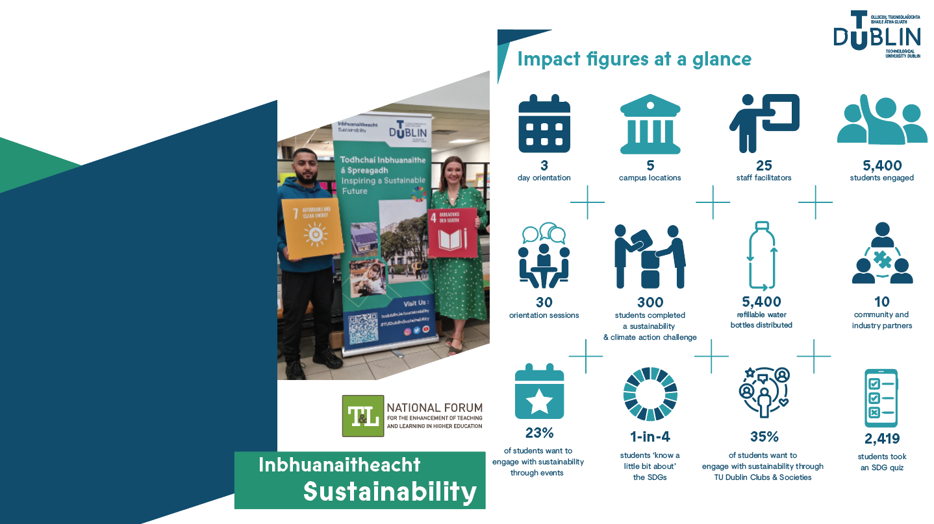
Sustainability
and Climate Action
Orientation 2024
Faculties & Schools work to embed sustainability within the curriculum to enable & empower students to progressively develop their sustainability knowledge & skills in a manner which is clearly linked and applied
to their programme.

Slide 12
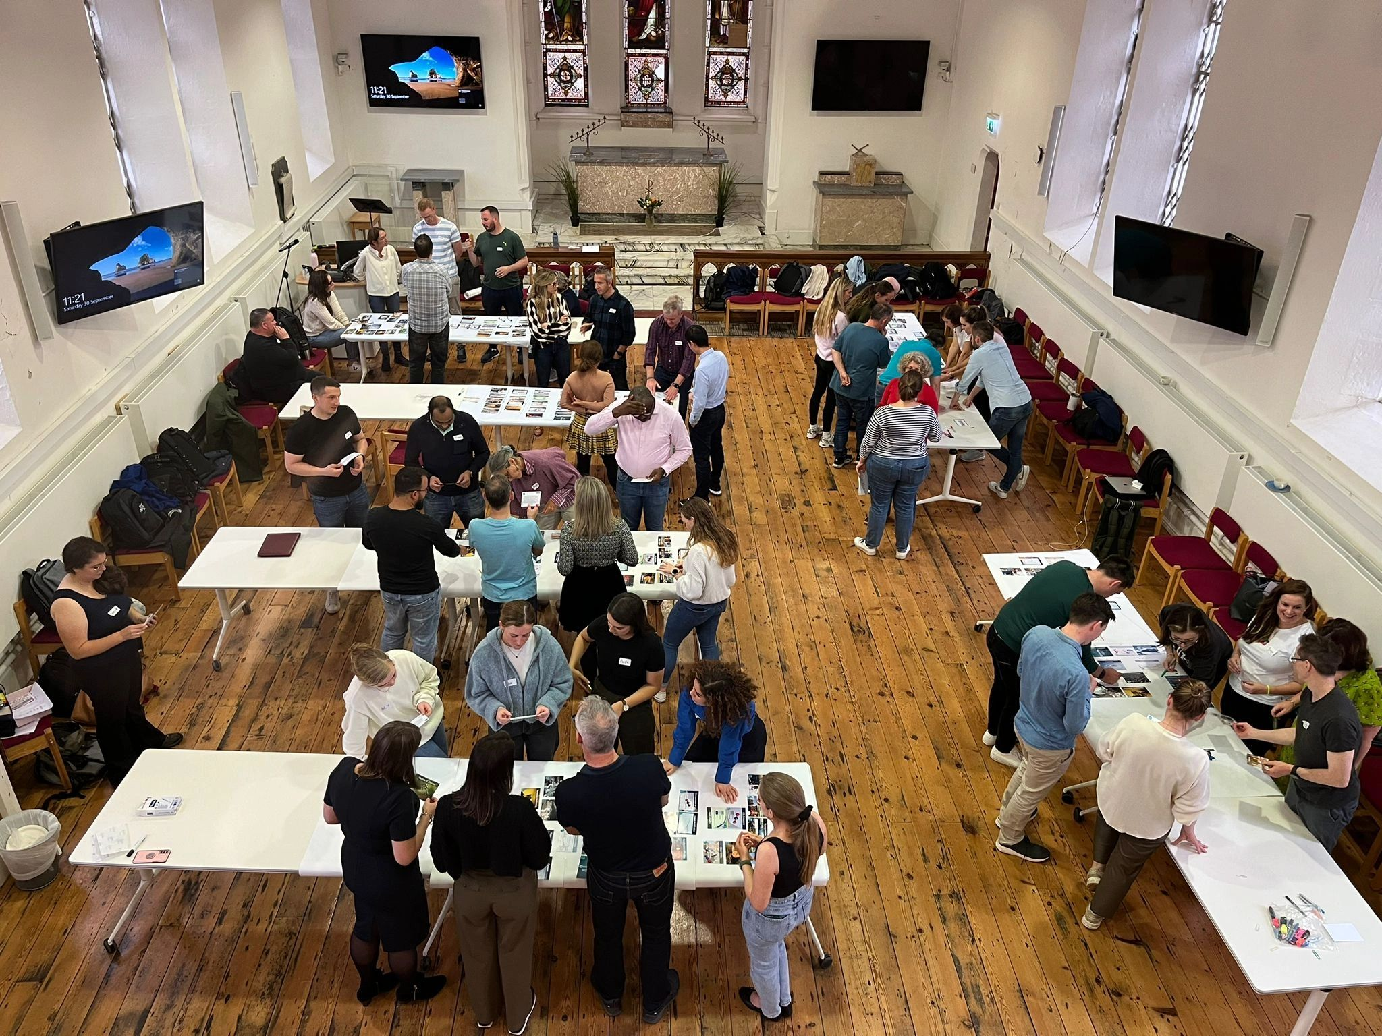
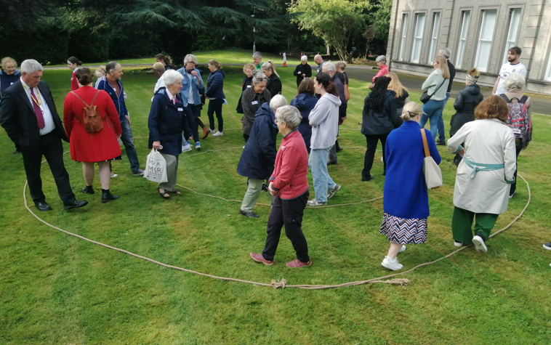
Other workshops
Climate Fresk
Stepping into Doughnut

Slide 13
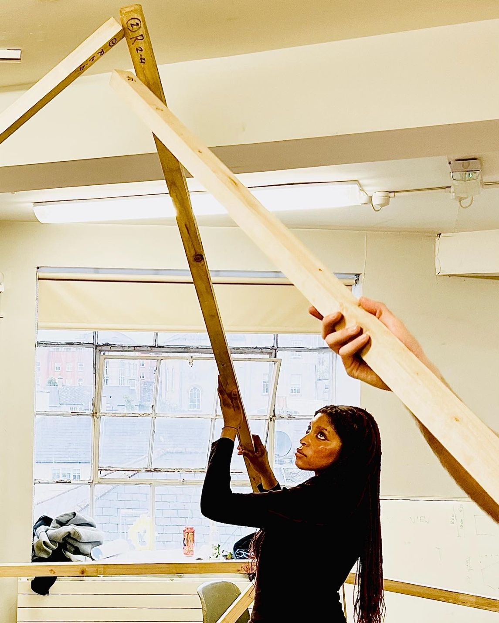
Sustainable shelter
sleep-out
12 groups of students on the BSc (Hons) in Architectural Technology at TU Dublin were tasked with designing and building a structure that could survive out in the open for a single night.
Will they survive and what will they learn?
Notes:
This initiative encouraged students to make balanced design decisions rather than typical aesthetic-driven approaches. They now have a clear memory of the difficulty of finding and transporting materials, the risk of assembling them in the wind and rain, the potential discomfort of heat loss and water ingress during that night, and the effort of dismantling components and storing them; all lessons that will hopefully translate into their careers and decision-making. The students partaking in the project have raised over €5,000 for Focus Ireland’s Shine A Light homelessness charity in 2023 but have raised over €10,000 across 3 years. Overall, there were very good learning outcomes achieved for our students, for a very good cause

Slide 14
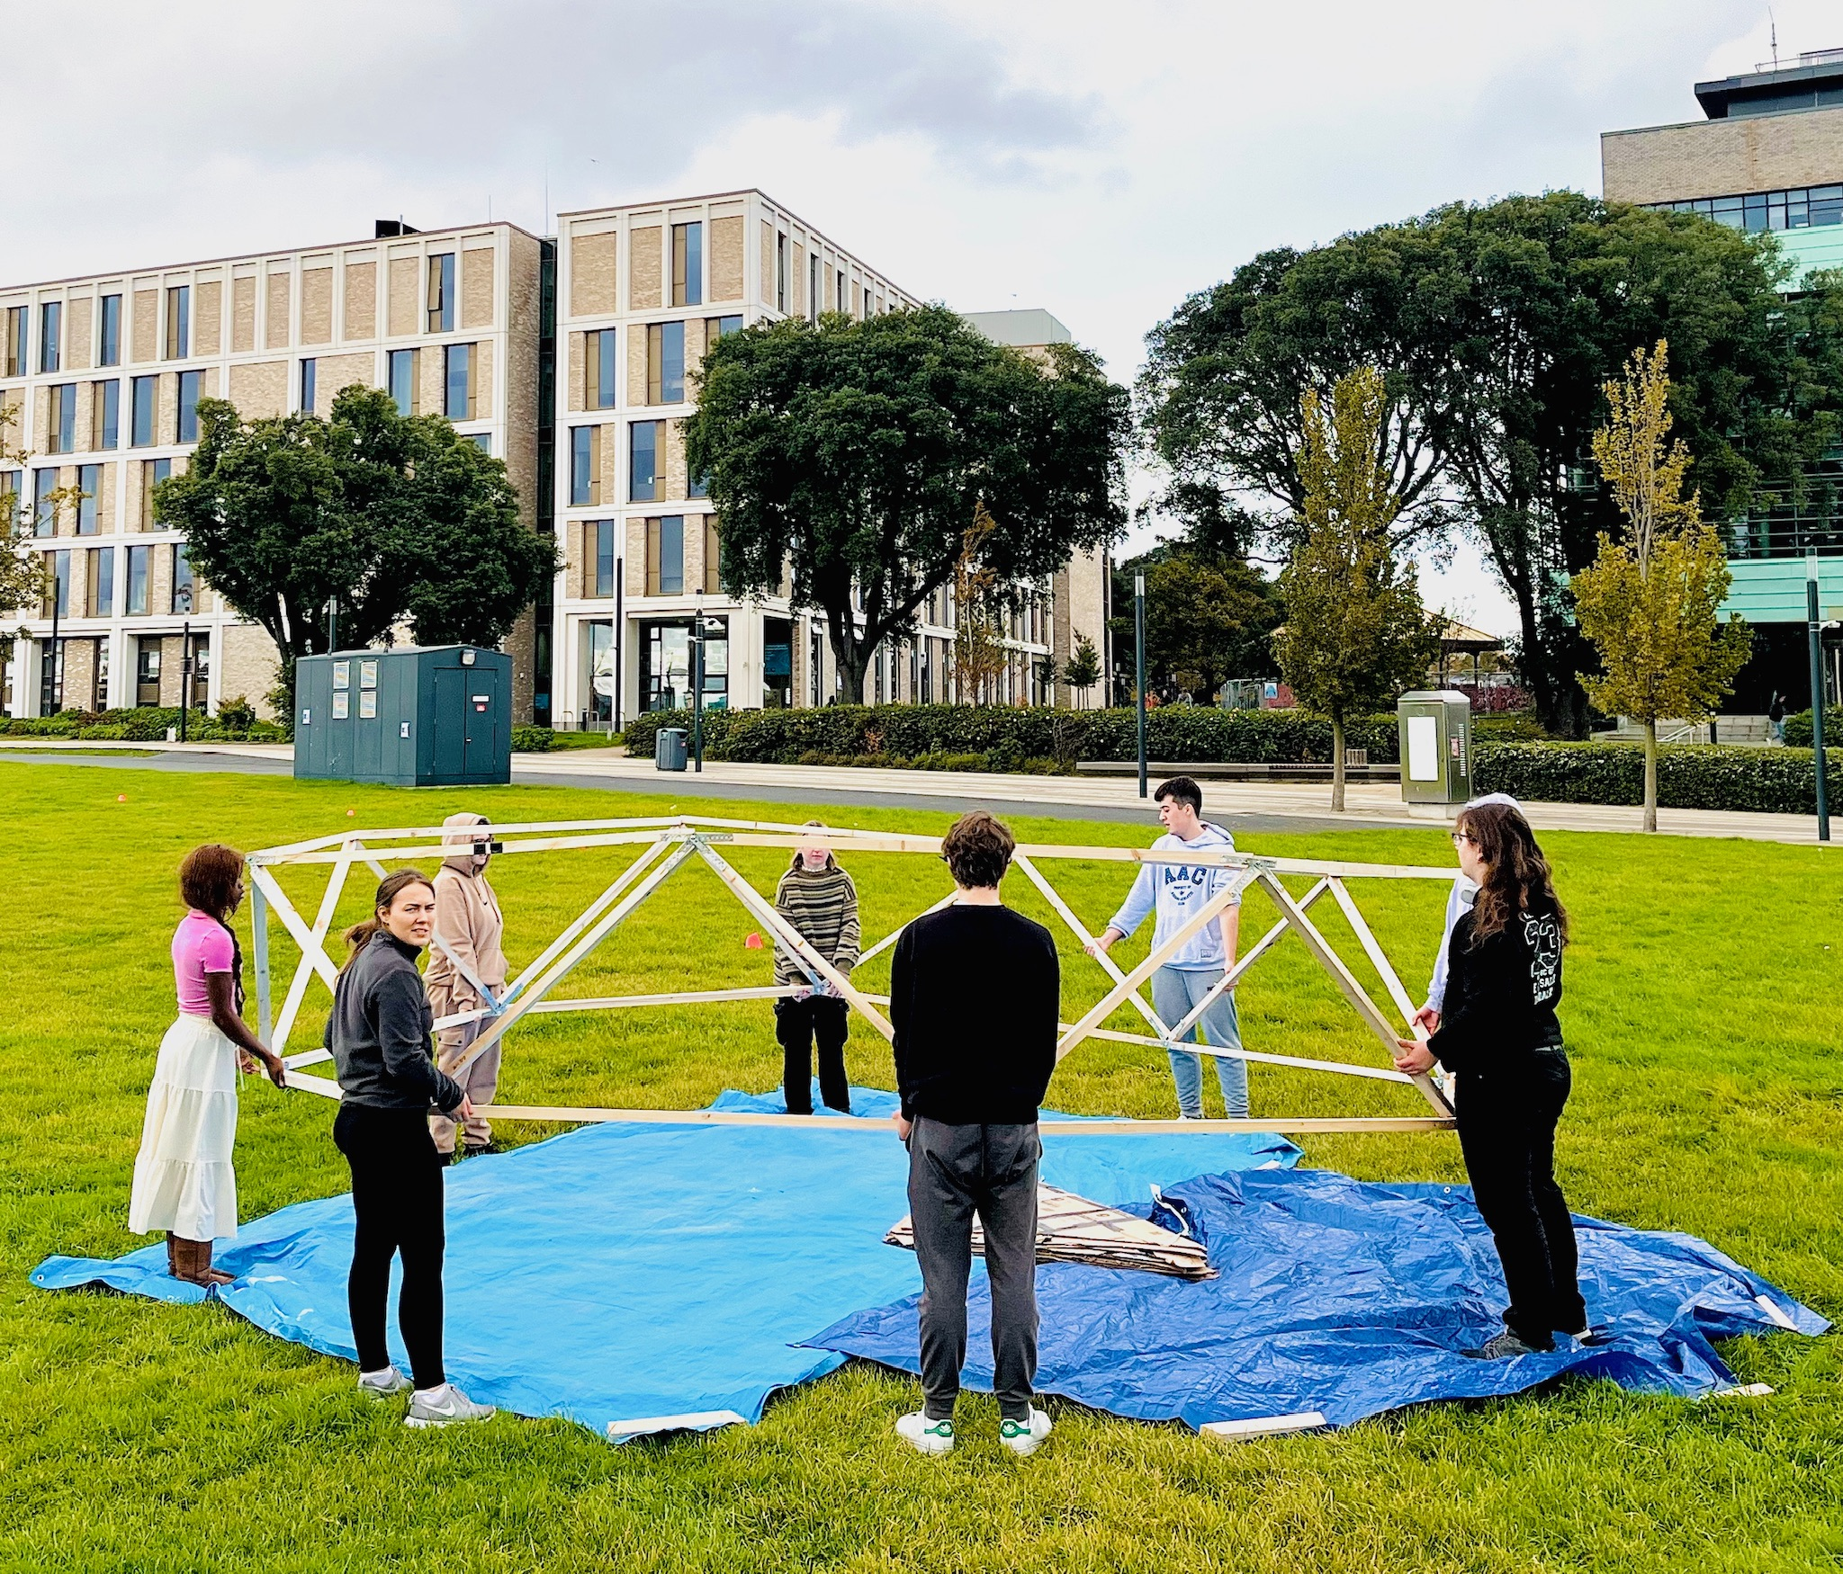
Design and build a shelter to hold 9 of your classmates.
Survive for one night out in the open in October.
Maintain 20 degrees. Min. 500 Lux. Stay dry!
Notes:
The project was initially conceived as a way of introducing new college students to the basic concepts of architecture and shelter along with environmental and social sustainability in a highly visceral way to align with SDG 11; Sustainable Cities. However, a set of assessment criteria were used to elevate the project to a genuine design challenge. The idea of actually experiencing the act of transporting materials and assembling elements to create a simple shelter to house 10 people, meant that students would have real-world consequences for their design decisions. Students were required to dismantle the structures the next morning and carry them back to the college also for reuse for the following year. They therefore had to carefully weigh decisions of cost and comfort versus physical effort and aesthetics. This issue of people being disconnected from the impact of their decisions drove many aspects of the assignment. We continually asked the question “how can we demonstrate and reveal the chain of choices which lead to more sustainable outcomes?”.

Slide 15
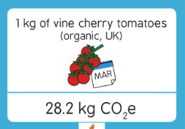
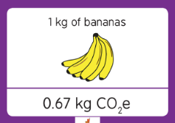
Teaching Innovation
How bad are bananas?
Which has higher carbon footprint?

Slide 16
Teaching Innovation
How bad are bananas?
Which has higher carbon footprint?

Slide 17
How much more energy does a ChatGPT prompt use than a Google search?
The same
x 2
x 10
x 25

Slide 18
How much more energy does a ChatGPT prompt use than a Google search?
The same
x 2
x 10
x 25

Slide 19
Thank you! https://www.tudublin.ie/sustainability/
#TUDublinSustainability

