Slide 1


ATU & Altitude
Scaling New Heights in Ireland:
ALTITUDE - The National Charter for Universal Design in Irish Tertiary Education
Dr. Niamh Plunkett, Maureen Haran, (ATU)

Slide 2
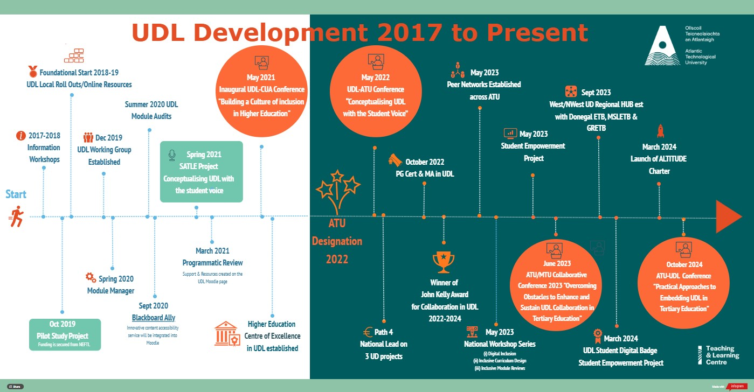
ATU UD/ UDL Development Timeline

Slide 3

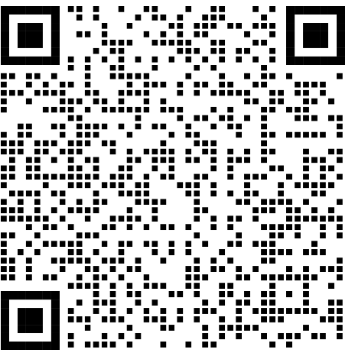

Policy and Sectoral Context

Slide 4
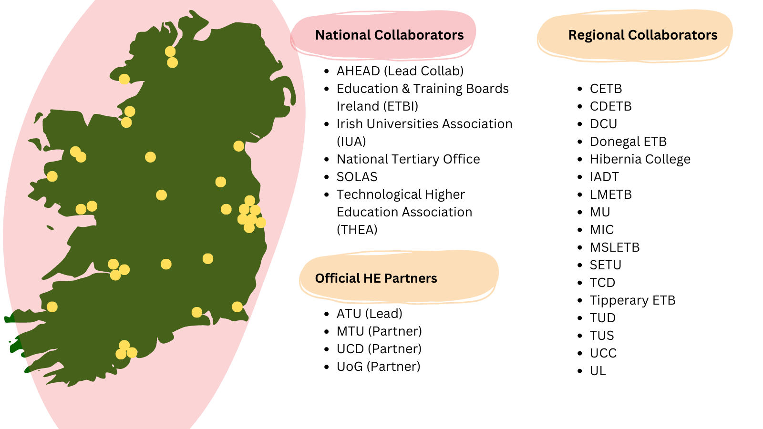
Who’s Involved?

Slide 5





ALTITUDE - Project Outputs
Vision of the ALTITUDE Project
“Tertiary education institutions where all learners are transformatively included through universal design in education.”
Mission of the Project
“To support HEIs and ETBs to make sustainable progress towards systemically embedding a universal design approach, which places human diversity at the heart of tertiary education design and fosters student success for all.”
ALTITUDE Charter
UNLOCKING INCLUSION TOOLKIT – Supporting Implementation
Technical Report

Slide 6
Development of the Charter
Strategic Foundations & Scaffolding
Learning, Teaching & Assessment | Supports, Services & Social Engagement | Physical Environment | Digital Environment
(Burgstahler, 2009; Kelly & Padden, 2018)
Deep Literature Review
Significant Staff & Student Consultation
Huge Cross Sectoral Collaboration
Senior Stakeholder Dialogue

Slide 7
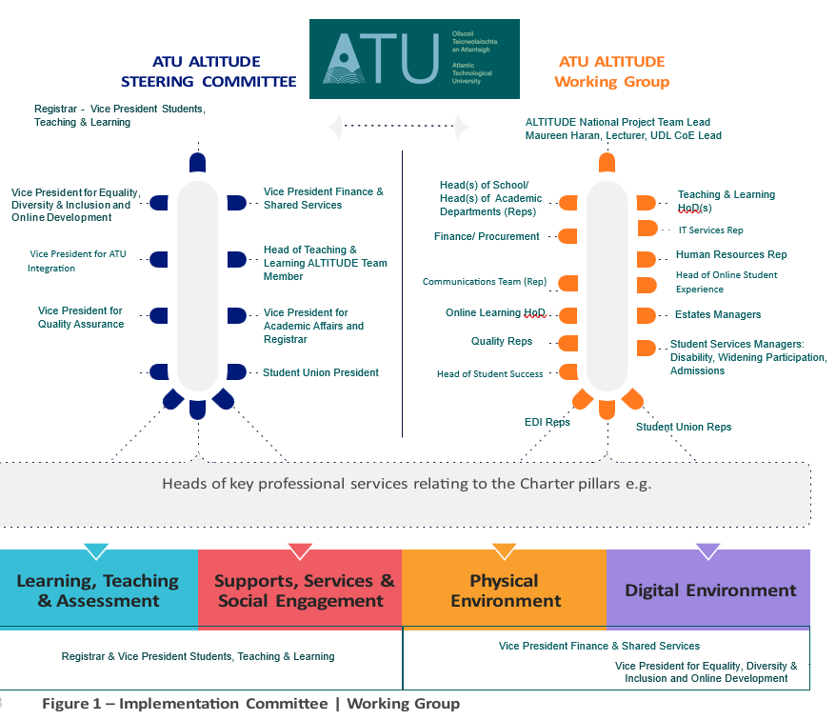

ATU Adoption Plan
This Photo by Unknown Author is licensed under CC BY-NC-ND

Slide 8

Inside the ALTITUDE Charter
Develop Strategic Enablers Over Time
Implementation
Committee/
Working Group
Advance Pillar-Based Goals and Related Actions
Learning, Teaching, & Assessment | Supports, Services & Social Engagement | Physical Environment | Digital Environment

Slide 9
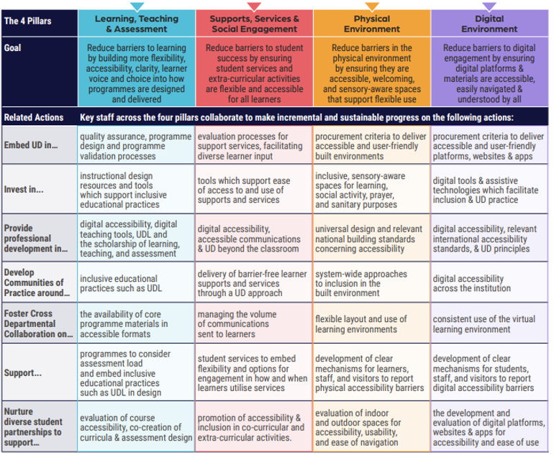
ALTITUDE
Charter

Slide 10
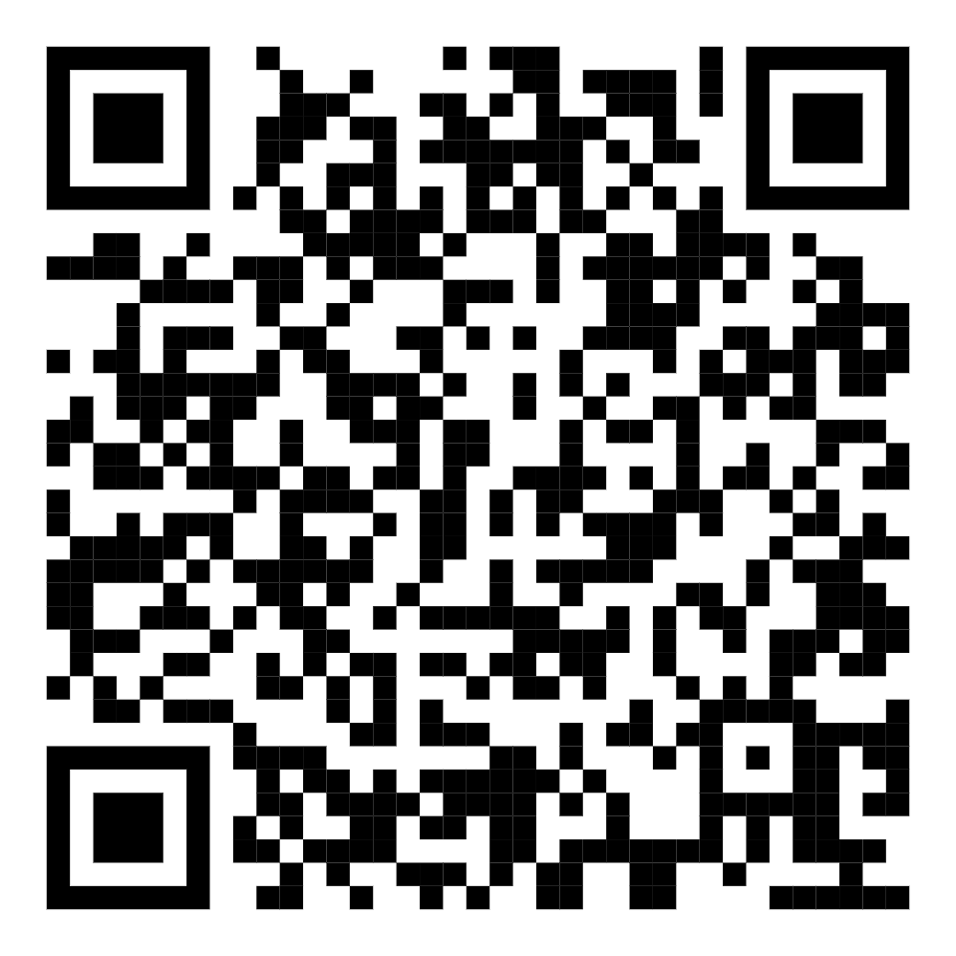
What’s Next?
Your Call to Action: Begin Strategic Dialogue in Your Institution – Don’t Wait - Get moving!
ALTITUDE Community in development- Express your interest (currently 95 members)
National Adoption Process Development – Senior Stakeholder Group being formed
For more information contact:
maureen.haran@atu.ie (ALTITUDE Project Lead)
niamh.plunkett@atu.ie ( Head of Teaching & Learning ATU Sligo)
Go to the Project Webpage
Shareable Video on the Charter
Join the ALTITUDE Community mailing list for news and updates to your inbox:

