Slide 1




Initial reflections on the impact of a 2 year programme of transformation across the TU sector
Dr Sharon Flynn,
National Coordinator, N-TUTORR
HEA Teaching & Learning Conference 2024
12 December 2024

Slide 2








6
4
12
4,000
9,600
€40
2
7
21
Notes:
What is N-TUTORR?

Slide 3
6
4
12
4,000
9,600
€40m
2
7
21
Notes:
What is N-TUTORR?

Slide 4
6
4
12
4,000
9,600
€40m
2 years
7
21
Notes:
What is N-TUTORR?

Slide 5
6
4
12
4,000
9,600
€40m
2 years
7 HEI partners
21
Notes:
What is N-TUTORR?

Slide 6
6 themes
4 work streams
12 work packages
4,000
9,600
€40m
2 years
7 HEI partners
21
Notes:
What is N-TUTORR?

Slide 7
6 themes
4 work streams
12 work packages
4,000 staff
9,600 students
€40m
2 years
7 HEI partners
21
Notes:
What is N-TUTORR?

Slide 8
6 themes
4 work streams
12 work packages
4,000 staff
9,600 students
€40m
2 years
7 HEI partners
21 PSB meetings
Notes:
What is N-TUTORR?

Slide 9

Time

Slide 10

Change

Slide 11

Capacity

Slide 12

Community

Slide 13

Collaboration

Slide 14

Students

Slide 15
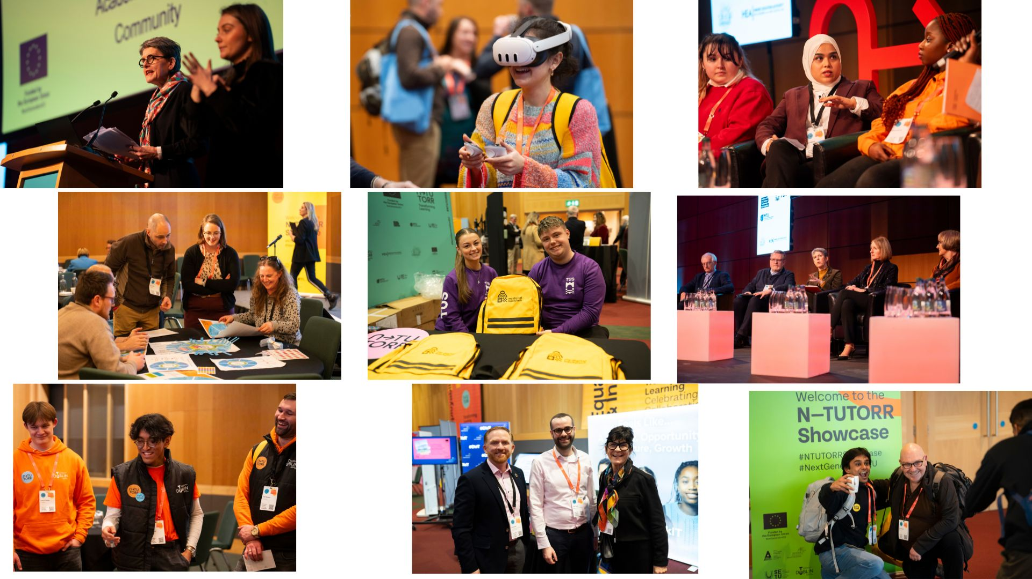

Slide 16



transforminglearning.ie
Sharon.Flynn@thea.ie
ntutorr.ie
linkedin.com/company/ntutorr/
Notes:
More info

