Slide 1


Driving Changes in Teaching and Learning through Policy and Innovation
Executive Briefing
December 12th, 2024

Slide 2
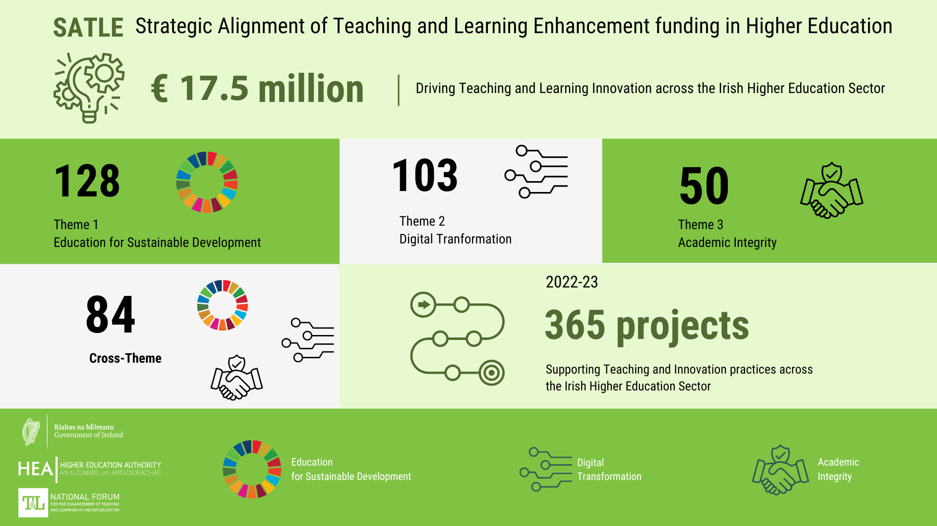

Slide 3

6,000 participants to date. 1,300 in 2024.
950 trained facilitators, helping to scale this impact even further across HEIS.

Slide 4


Slide 5
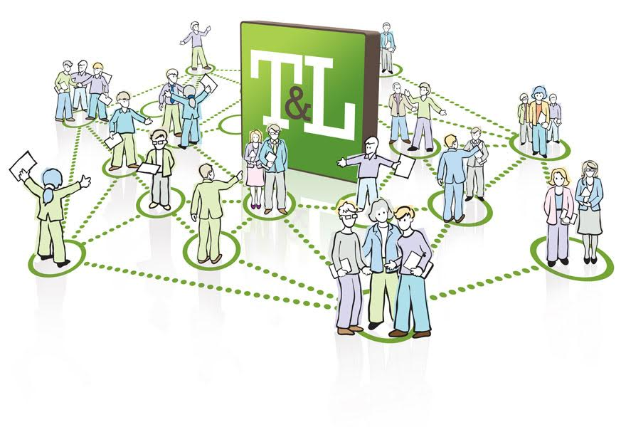

Slide 6


Education for Sustainable Development
Embracing holistic transformation

Slide 7
Definition
‘ESD empowers learners with knowledge, skills, values and attitudes to take informed decisions and make responsible actions for environmental integrity, economic viability and a just society empowering people of all genders, for present and future generations, while respecting cultural diversity. ESD is a lifelong learning process and an integral part of quality education that enhances cognitive, social and emotional and behavioural dimensions of learning. It is holistic and transformational and encompasses learning content and outcomes, pedagogy and the learning environment itself.’

Slide 8
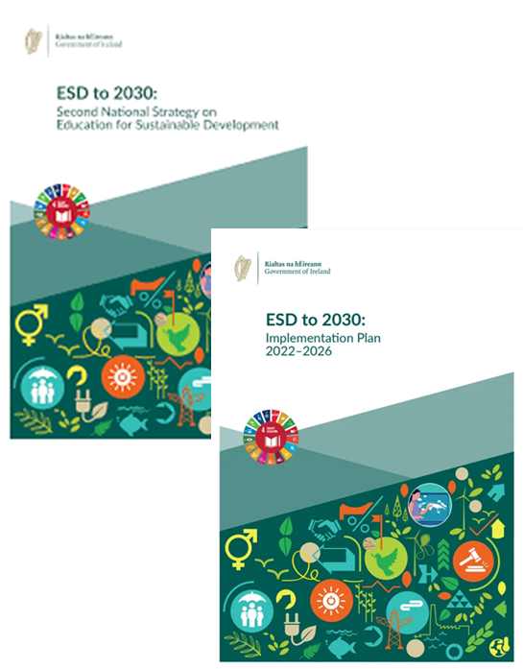
ESD to 2030
Priority Action Areas Transforming Learning Environments Building Capacities of Educators Whole-of-institution approaches. Interdisciplinary research that addresses ESD and the SDGs. Campus-wide sustainability literacy. Project-based and place-based learning i.e., outdoor learning. Embed across the whole curriculum.

Slide 9
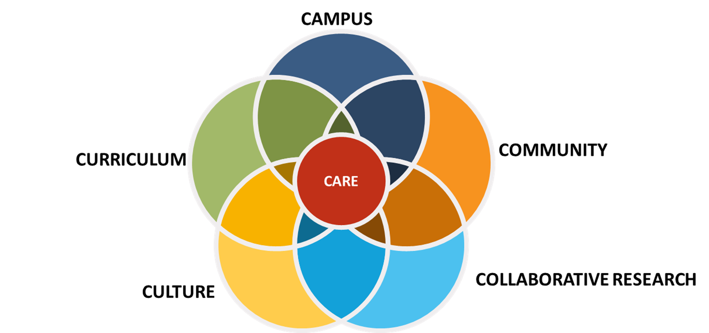
How can our campuses become dynamic and creative living labs?
How can we learn from with and as communities?
How can we move from learning ABOUT to learning AS sustainability?
How can we mobilize collaborative research for climate action and climate justice?
How can we become a ‘beacon’ for climate action leadership?

Slide 10
2025
First Steps… ESD Community of Practice for ESD Leads within universities.
Weekly ESD Spotlight Series

Slide 11

Many thanks for listening
Mark Kelly
mkelly@hea.ie
www.teachingandlearning.ie
@ForumTL

Slide 12
Professional development, recognition and the impact of teaching and learning in higher education
Dr. Sharon McGreevy

Slide 13
Definition of Recognition
Recognition is the act of acknowledging, thanking and praising staff for their contributions, both formally and informally. (Gallup and Work human report 2023)
Recognition is the appreciation someone shows for another’s achievements, performance, contributions or abilities (Universitas 21)
Recognition means being acknowledged, identified, perceived and esteemed in your role. Crone et al (2023, p371)
www.teachingandlearning.ie
@ForumTL

Slide 14
Recognition Vs Accreditation
Developing a common understanding of the difference between evidenced-based provision (or ‘recognition’) and formal credit-bearing provision (‘accreditation’).
Achieving parity of esteem and valuing teaching
www.teachingandlearning.ie
@ForumTL

Slide 15
Purpose of a Recognition Framework
Advantages of an Irish Recognition framework
Thank you
smcgreevy@hea.ie
www.teachingandlearning.ie
@ForumTL

Slide 16
Artificial Intelligence in Teaching & Learning
James O’Sullivan
josullivan@hea.ie

Slide 17
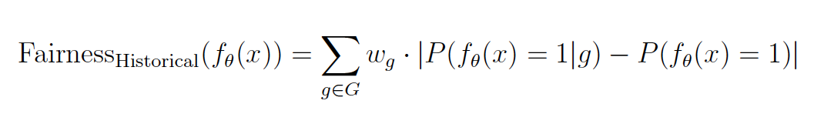
Title
AI literacy
AI taxonomies
Allowable AI
Academic integrity
Critical AI
Second-degree plagiarism
Privacy
Equitable access
Sustainability
AI sovereignty
Enhancement

Slide 18


This initiative led by the Centre of Academic Practice, Trinity College Dublin, started in November 2023.
It aimed to gather initial and explorative teaching practices embedding GenAI in Higher Education.
With Co-editors from 7 other universities, worked collaboratively to create an Open Source that compiles 30 examples from the disciplines to reflect, learn and enhance the teaching and learning process using GenAI tools.
This open Source will be launched in a hybrid format on January 23rd, 2025.
Please, save the date. More information will be available in early January.
For more information, please contact: schalka@tcd.ie

Slide 19
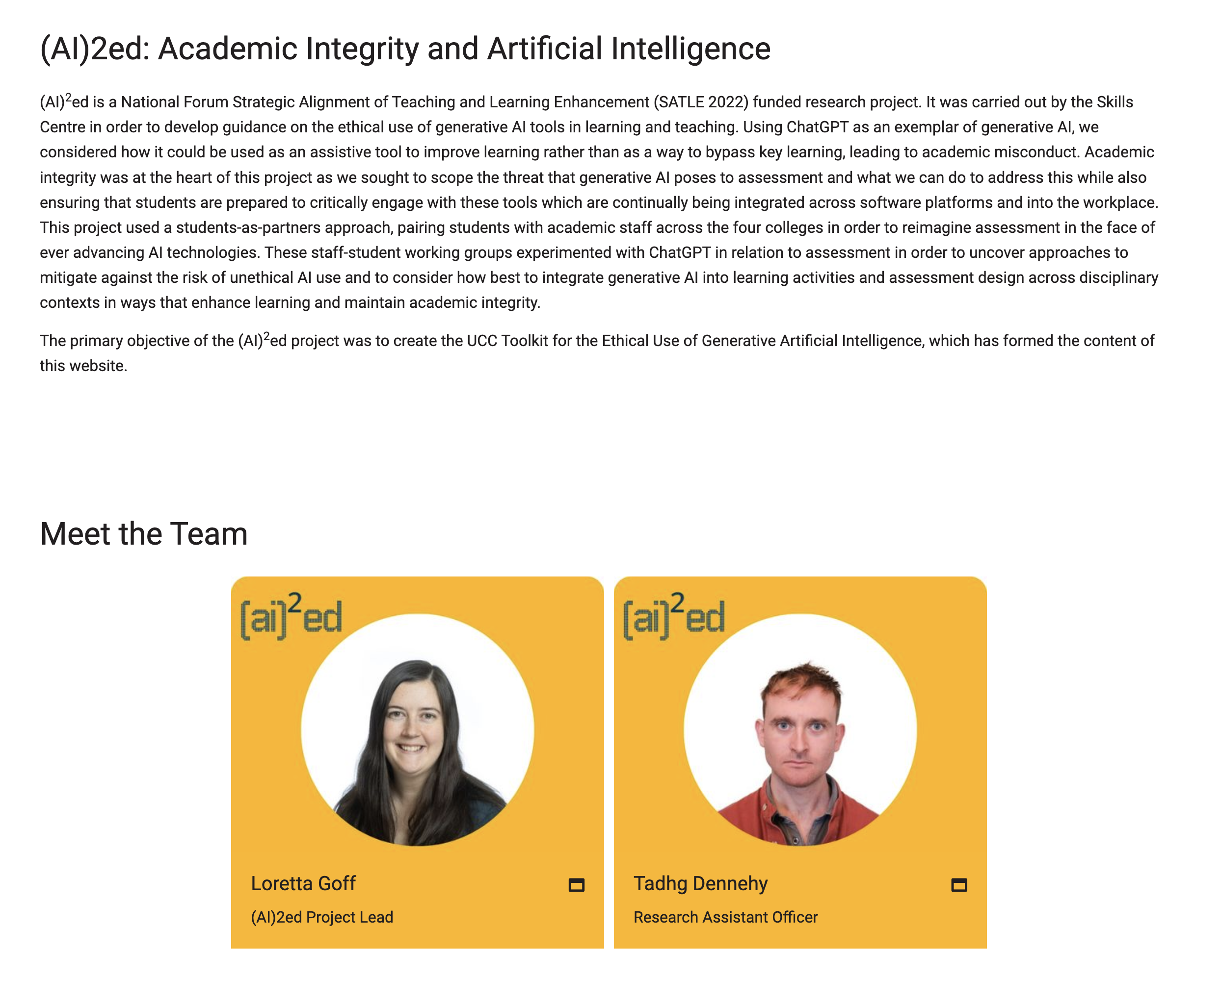
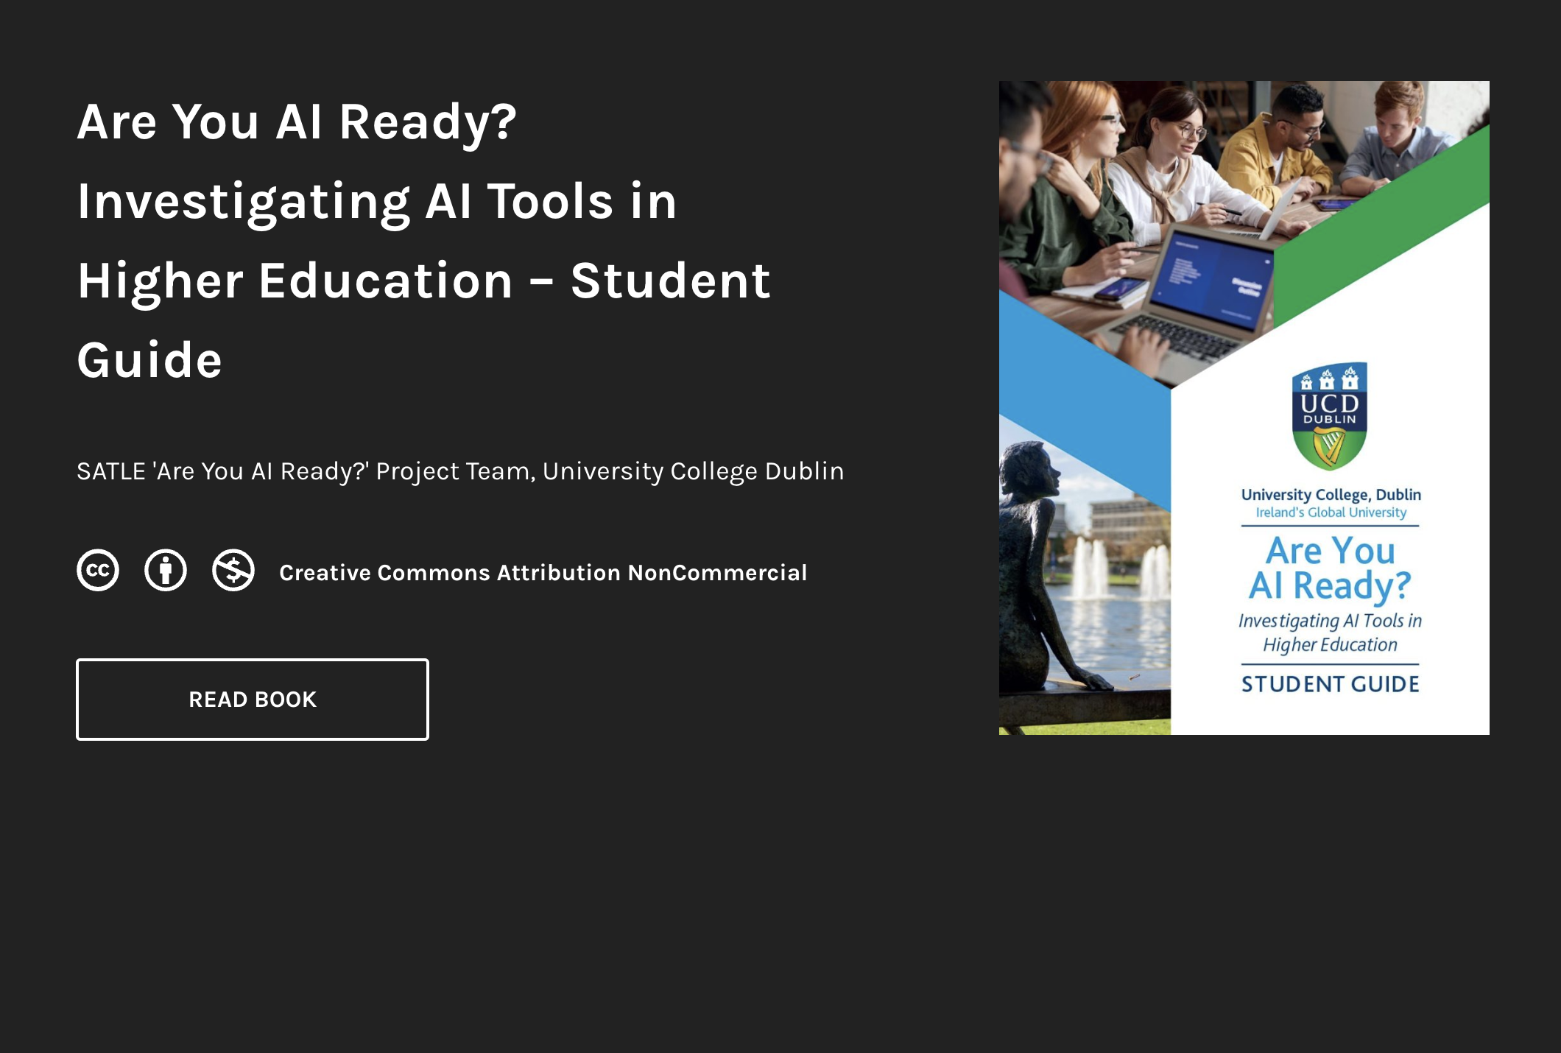


Slide 20
Many thanks for listening
James O’Sullivan
josullivan@hea.ie
www.teachingandlearning.ie
@ForumTL

Slide 21
Driving Changes in Teaching and Learning through Policy and Innovation
Student Success in Further and Higher Education
Rebecca Roper
rroper@hea.ie
December 12th, 2024

Slide 22

Things have changed…
Before, Now, Tomorrow
Dave Columbo TikTok

Slide 23
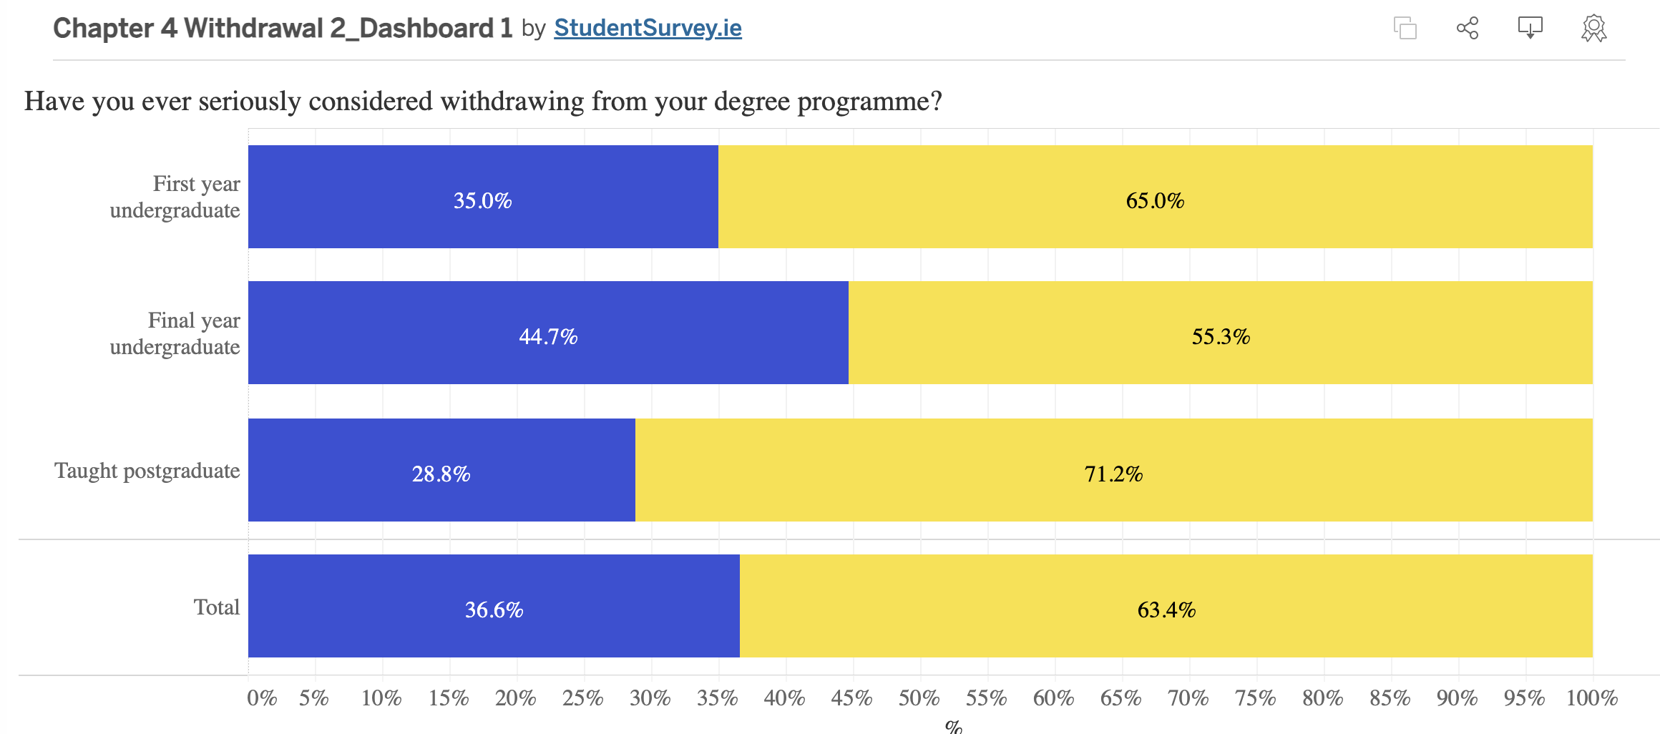
NStEP: 63% of Student Reps working in addition to their studies
18% work full time
Student numbers in Higher and Further Education are increasing

Slide 24
survey.ie
Comparing baseline (2018-2020) scores of the (then) nine student engagement indicators (below) with those obtained in 2021, the following were observed to be most significantly affected:
Collaborative Learning
Student-Faculty Interaction
Quality of Interactions
Supportive Environment

Slide 25
National Understanding of Success
“Student success optimises the learning and development opportunities for each student to recognise and fulfil their potential to contribute to, and flourish in, society.
To be achieved, this requires a culture in Irish higher education that values inclusivity, equity and meaningful engagement between students, staff, their institutions and the wider community.”

Slide 26
Student Engagement…
“Student Engagement is a collaborative commitment between institutions and students that values and fosters a social and educational environment, where students feel they belong; are empowered to actively participate in learning; realise their potential and engage meaningfully with their institution and in society.”
Definition agreed by the Student Engagement and Teaching and Learning Committee (SETLC) on 6th June 2024

Slide 27
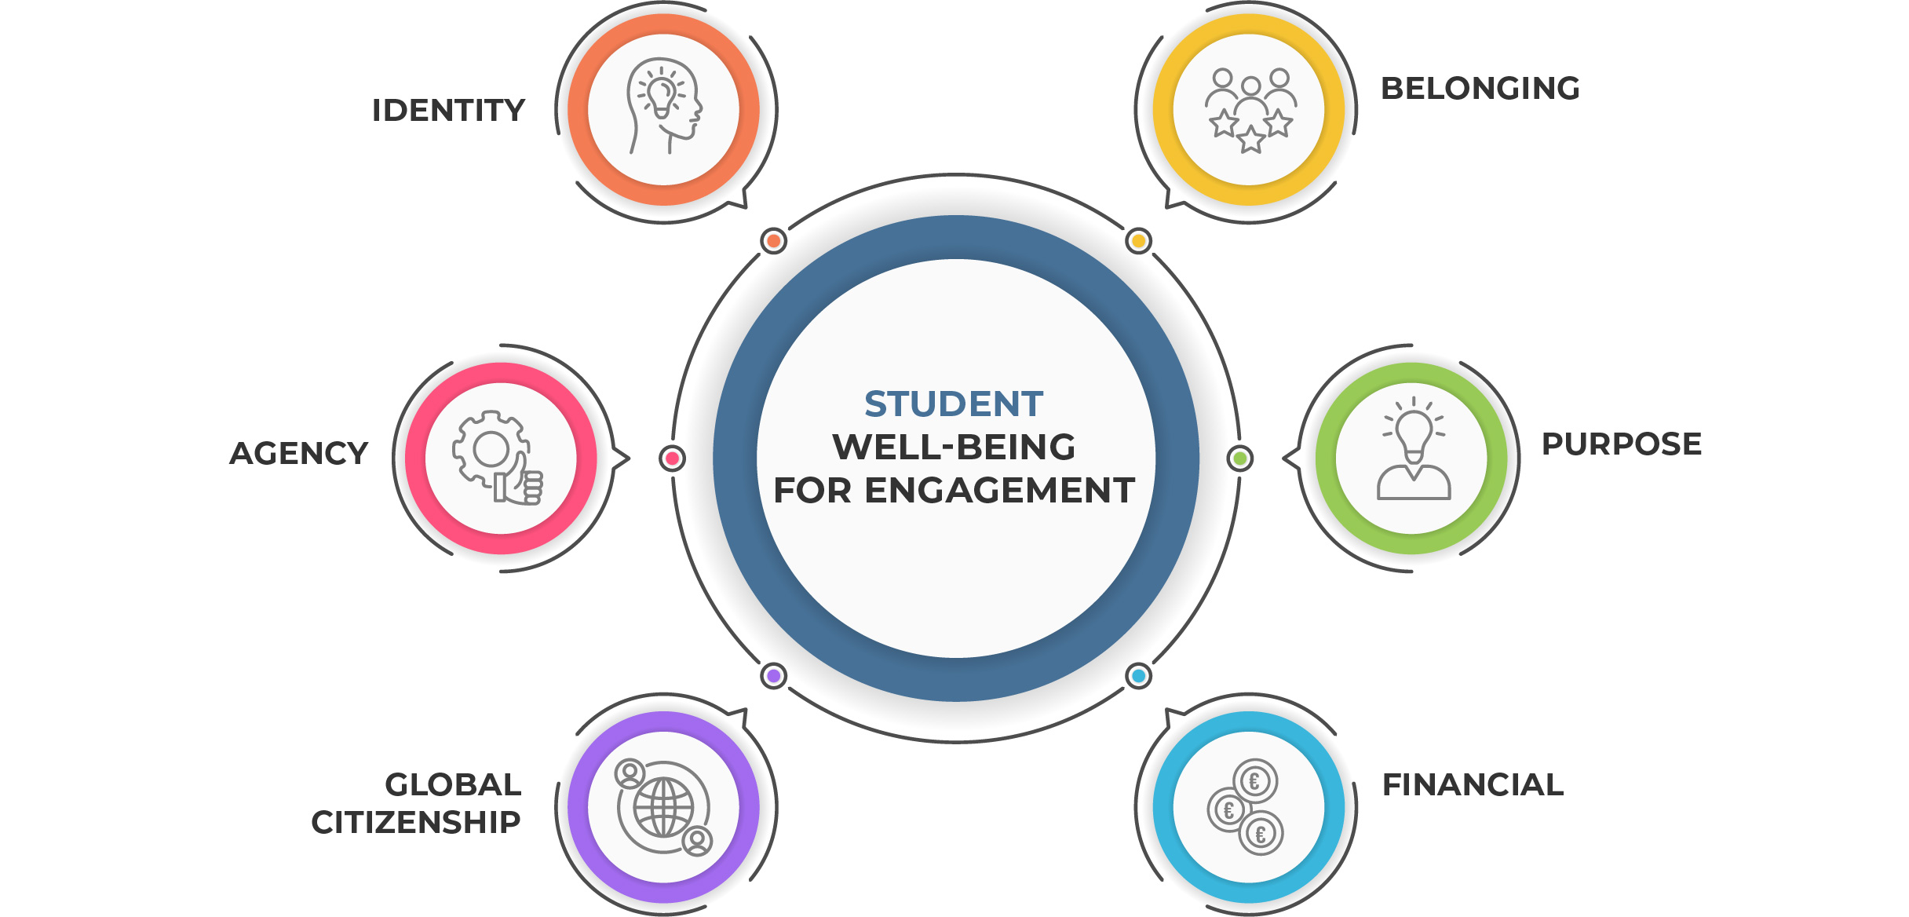
Image adapted from:
White, H. et al (2024). 'Cultivating long-term well-being through transformative undergraduate education’
Adapted image by Justyna Doherty

Slide 28
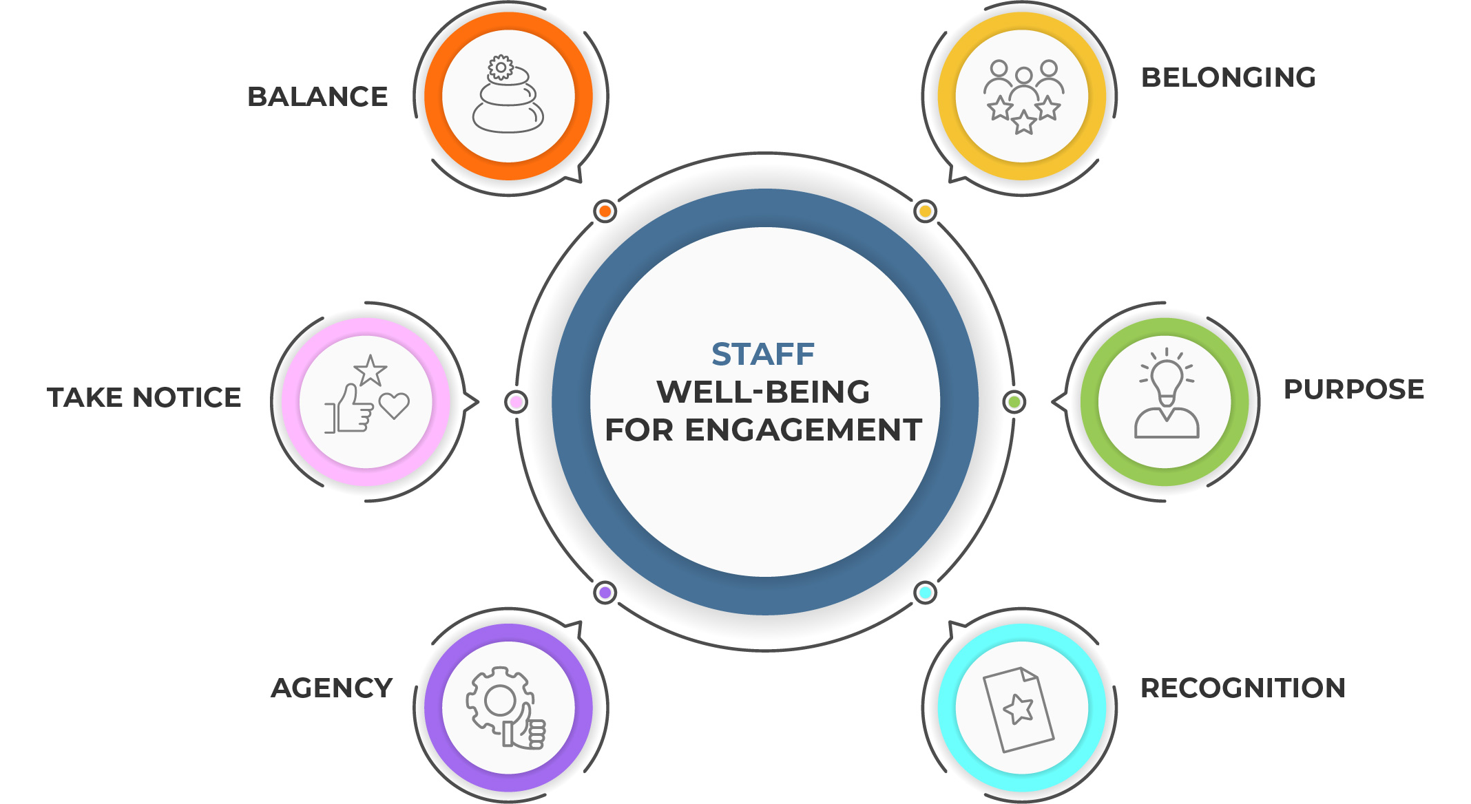
Image by Justyna Doherty

Slide 29
High-Impact strategies to engagement and success:
Fostering Mattering and Agency – collaborative learning, student-staff partnerships
Extended orientation in 1st years
Supporting lecturers in leadership roles and educational environments
Work placements, altruism projects, leadership opportunities for all students
Incorporate Universal Design for Learning in teaching and learning
Real-world projects
Relevance in curriculum design
Institutional habitus

Slide 30
How might we…
Meet students where they are and support them to achieve their goals?
Cultivate a culture of wellbeing for all staff and students?

Slide 31
Next Steps
Work is currently underway by an expert panel to make recommendations on Student Success and the Framework.
Reporting next Spring/early Summer.
Please get in touch:
rroper@hea.ie

Slide 32
References/further reading
Authority, H. E. (2022). ‘An Analysis of Non-Progression Rates in Irish Higher Education Institutions – Overview and Key Findings.’ Available fromhttps://hea.ie/statistics/data-for-download-and-visualisations/access-our-data/Access%20our%20Data%20-%20Students/
Dempsey, M. & Burke, J. (2021) Lessons Learned: The experience of teachers in Ireland during the 2020 pandemic. Maynooth: Maynooth University. https://mural.maynoothuniversity.ie/13914/1/Teacher_COVID_Report_Final_21.01.21.pdf
Fede, J. H., Gorman, K. S., & Cimini, M. E. (2018). Student Employment as a Model for Experiential Learning. Journal of Experiential Education, 41(1), 107-124. https://doi.org/10.1177/1053825917747902
Gravett, K. Carol A. Taylor & Nikki Fairchild (2024) Pedagogies of mattering: re-conceptualising relational pedagogies in higher education, Teaching in Higher Education, 29:2, 388-403, DOI: 10.1080/13562517.2021.1989580
Ryan, M. (2021) Compendium of Active Learning Strategies for Student Engagement, Technological University of the Shannon (TUS). https://hub.teachingandlearning.ie/wp-content/uploads/2024/04/TUS-Compendium-of-Active-Learning-Strategies-for-Student-Engagement.pdf
Swanson, E., Cole, D. (2022) The Role of Academic Validation in Developing Mattering and Academic Success. Res High Educ 63, 1368–1393
Tierney, S. (2021). Leadership: Being Knowing, Doing. Melton: John Catt Educational, London.
White, H.C., Allen, D.M., Buffinton, K., Humphrey, D., Malpiede, M., Miller, R.K. & Volin, J.C. 2024, 'Cultivating long-term well-being through transformative undergraduate education', PNAS Nexus, vol. 3, pgae372. DOI: 10.1093/pnasnexus/pgae372.

