Slide 1
H I G H E R
F u t u r e s
Higher Education Authority
Practices, diversity and technology: making choices about teaching and learning
Professor Sir Chris Husbands
December 2024

Slide 2
perspectives
...what has shaped my recent thinking
challenges
…the context for teaching and learning
questions
…for leading teaching and learning

Slide 3


Perspectives

Slide 4

Perspectives
Perspectives
Shaping institutional mission at Hallam
Distinctiveness
Our history, values, and place make us special:
an applied university
1.5 cm
1.5 cm
Quality
The challenge is to be consistently excellent in realising our mission

Slide 5
The Hallam Model: curriculum design
Perspectives
Perspectives
engage
challenge
thrive
collaborate
Global
Community
Cross-boundary working

Slide 6
Perspectives
Perspectives
The UK Teaching Excellence Framework
National audit of institutional drivers of student outcomes and experience
Four levels of award:
Gold,
Silver,
Bronze,
Requires Improvement
Indicator set, institutional submission, student submission and contextual data
Judgements across HE, FE, ‘alternative’ providers
Led to three judgements [student experience, student outcomes and overall] based on 13 criteria

Slide 7
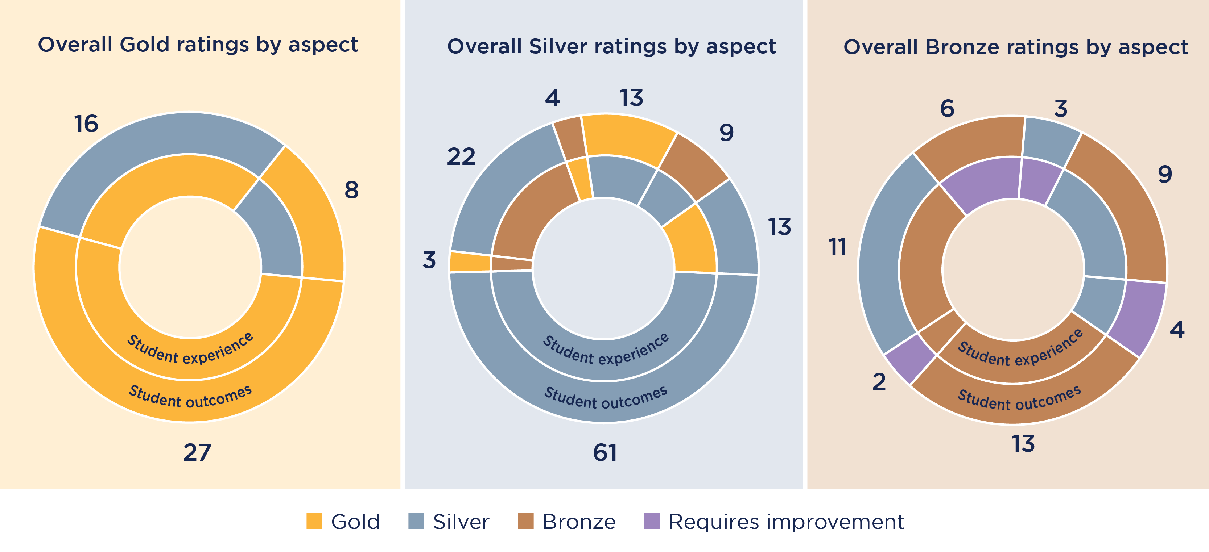
Perspectives
The UK Teaching Excellence Framework
clear articulation of institutional goals, context and practices
data on specific elements and groups
evaluation of gain and impact
Notes:
\

Slide 8
Perspectives
IHEA Student Success Framework
…beautifully clear
….strong on institutional embedding
….intertwining of capabilities, culture and practices

Slide 9



Challenges
The changing context for teaching and learning
Accelerating societal change and challenge
The power, potential and dangers of digital technologies
Increasingly diverse student populations
The long shadow of the pandemic
Governments and higher education
Mass higher education
Higher education
Students
Society and technology

Slide 10
Three strategic questions for leading teaching and learning
Challenges
Students
How does the increasing diversity of student populations impact teaching?
Technology
How can universities minimise the risks, maximise the advantages and creatively deploy AI?
Institutional choices
What is your institutional value offer and delivery proposition?

Slide 11
How does the increasing diversity of student populations impact teaching ?
Questions
Increasingly varied populations
Increasingly different experiences of university
Increasing diversity in aspiration and trajectory
All impact on student support and teaching

Slide 12

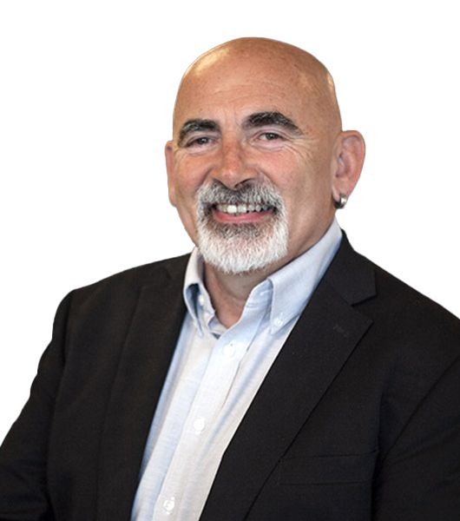
AI and universities: benefits and risks
Questions
Potential benefits
Potential risks
personalised/targeted learning
technology replacing human interaction
ultra rapid synthesis
untraceable cheating
complex pattern recognition
algorithmic biases
adaptive learning experiences
replacing human judgement/relationships
teaching workload reduction
algorithmic biases
preparation for workplaces
needs tough regulation
Source: Wiliam and Hattie

Slide 13
AI and universities: maximise and deploy
Questions
Staff need AI literacy to engage with capabilities and risks
Students need AI literacy to engage with capabilities and risks
Guardrails and regulation
Equity of access matters
Assessment needs to be rebuilt
Students need to become expert users of AI
Professional development is key
Ethics matter
Ethics matter

Slide 14
What is your institutional value offer and delivery proposition?
Questions
How (exactly) does your university create value?
What is the source of quality in that offer?
What shapes distinctiveness in that offer?

Slide 15
… four focus issues
Questions
value proposition
data and digital
responding to diversity
leadership

Slide 16
… four focus issues
Questions
What is your distinctiveness and quality offer?
How are you deploying data and digital technologies to drive that offer?
How are you understanding and meeting the needs of an increasingly diverse student population?
How are you developing leadership at every level to respond?

Slide 17
… four focus issues
Questions
value proposition
data and digital
responding to diversity
leadership

Slide 18
H I G H E R
F u t u r e s
Higher Education Authority
Practices, diversity and technology change: making choices about teaching and learning
Professor Sir Chris Husbands
December 2024

