Slide 1
Dr Ciara O’Farrell Keynote 1: Creating an Institutional Framework for Assessment OF, FOR and AS, Learning
Dr Ciara O’Farrell
Date 27/10/16
LIN conference

Slide 2
THE TRINITY EDUCATION PROJECT
Goal 3 of the Trinity Strategic Plan 2014-19 is to renew the Trinity Education, with a particular focus on the undergraduate curriculum.
Curriculum must continue to evolve in the light of new discoveries in discipline knowledge, pedagogies and the context of the 21st century graduate.
Rearticulate what a Trinity Education should be in the 21st Century.
Create a set of institutional Trinity graduate attributes and, using these attributes, agree curriculum principles and a programme architecture which supports their development and assessment.

Slide 3
Governance Structure
PROVOST
CHAIR
Project Manager
Steering Committee
Vice Provost & Chief Academic Officer Project Sponsor
I. STAKEHOLDER MANAGEMENT, COMMUNICATIONS
VP/Chief Academic Officer
II. CURRICULUM
PRINCIPLES &
ARCHITECT. LEAD
VP/Chief Academic Officer
III.
ASSESSMENT LEAD
Senior Academic Developer, Dr Ciara O’Farrell
IV. INTERNSHIPS and GLOBAL EXCHANGES
LEAD
VP Global Relations
V. TECHNOLOGY ENHANCED LEARNING LEAD
Assoc. Dean for On-Line Education/
Director IT Services
VI.
LEARNING
SPACES LEAD
Librarian/
Bursar & Director Strategic Innovation
VII. DIFFERENTIATION and POSITIONNG LEAD
Prof Geoghegan
Strand I Team
Strand II Team
Strand III Team
Strand IV Team
Strand V Team
Strand VI Team
Strand VII Team
D
Key: Colour coding denotes:
Align and integrate with University wide strategies and projects such as Library Strategy, Global Relations Strategy, E3 Strategy, Estates master-planning etc.
Steering Committee Members
Other team members
2

Slide 4
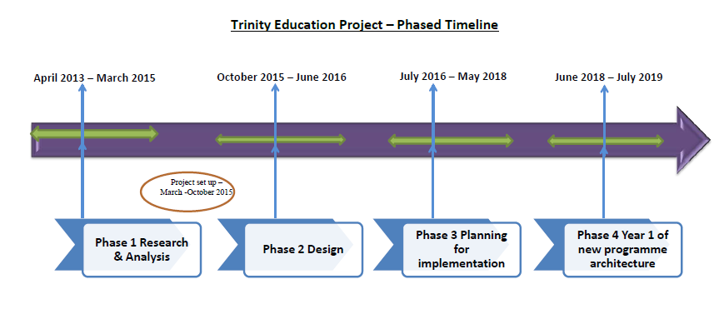
3

Slide 5
Assessment OF to FOR/AS learning
Genesis: ‘promote non-traditional modes of assessment’.
Cultural change.
Why move away from assessment OF learning?
Over reliance on a single approach, typically exams.
Limited range of assessment methods.
Increased complexity of learning needed for the 21st Century graduate cannot be adequately assessed through examinations (OECD).

Slide 7
Assessment Framework Recommendations
Graduate attributes
Programme approach
Range of assessment
4

Slide 8
Tenet: Assessment should support the acquisition of graduate attributes
Graduate Attributes: ‘the qualities, skills and understandings a university community agrees its students should develop during their time with the institution’ (Bowden et al. 2000).
The most successful evidence of the achievement of graduate attributes is when they are explicitly articulated, aligned and embedded in the curriculum and contextualized and assessed within the discipline (Hughes and Barrie, 2010).
Challenge: To embed graduate attributes incrementally and systematically throughout a programme; and support their achievement through a purposeful range of assessments.

Slide 9
Question
Does your institution have a set of graduate attributes?
Do you know where to find them?
Can you name them?

Slide 10
Graduate Attributes
What do you think are the most important skills, competencies and behaviours that graduates should possess upon completion of their undergraduate studies?

Slide 11
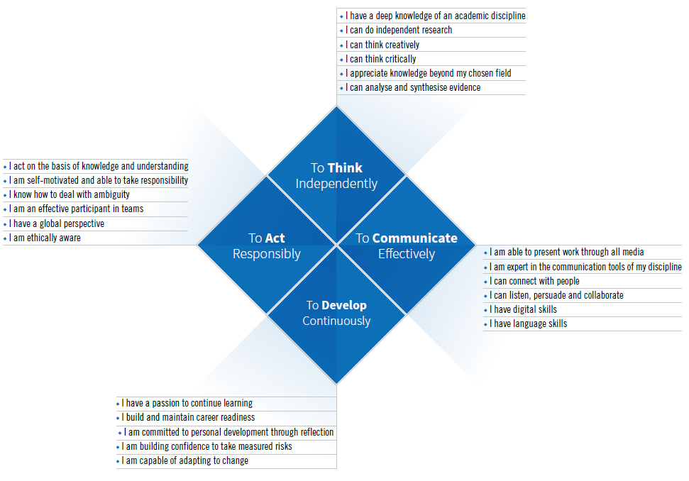
Graduate Attributes :
Approved by Council 8 June
6

Slide 12
Desired attributes
Universities should teach students ‘to think and to reason and to compare and to discriminate and to analyse.’ (Cardinal Newman, 1852).
Knowledge; intellect; willingness to learn; self­management skills; communication skills; team­working; and interpersonal skills (Lee Harvey and colleagues, 1997).
Enquiry; critical thinking, problem­solving, curiosity, teamworking, leadership; the ability to work across disciplines; ethical practice and communication skills (European researchers: Knight, 2003).
Gardner’s ‘5 minds for the future’ (2007): The disciplinary mind; the synthesising mind; the creating mind, the respectful mind; the ethical mind.

Slide 13
Irish context
14 semi-structured interviews with Industry leaders:
Independent thinking
Capacity for action
Teamwork
Communication skills
Emotional Intelligence (EI)
Capacity for continuous learning
(O’Farrell, unpublished: 2015)

Slide 14
Independent thinking/capacity for action
Discipline Knowledge
‘Their ability to perform the job at the level of functional expertise is a given.’ (Employer, 9)
Apply knowledge:
‘A lot of graduates need hand holding. They are rote learners and wait to follow a path. But sometimes they need to take their own path.’ (Employer 12)
Make connections:
‘[…] so they can go into complex situations, analyse the variables and find solutions.’ (Employer 7)
Integrative learning

Slide 15
Communication
‘No matter what discipline they are in, what area they work in, everyone must be able to communicate effectively and clearly what they do.’ (Employer 12)
‘You are empowering a 22 year old to talk on your behalf.’(Employer 3)
Irish graduates ‘less competent than their international counterparts at holding their own in a professional conversation’. (Employer 2)
‘In college they are all peers. They are not very good at building rapport with those outside of their peer group.’ (Employer 10)

Slide 16
Global Outlook and Emotional Intelligence
The capacity to deal with different cultures, value diversity and inclusion and ability to ‘build trust and social relationships’ (Employer 3) in a national and global context.
Graduates with ‘empathy and a social and ethical maturity‘ (Employer 13); ‘culturally sensitive’, ‘well rounded’.
Emotional Intelligence raised by almost all interviewed, with ‘personal transformation’, ‘self-awareness’ and ‘self regulation’ noted as crucial and often lacking in graduates.
‘professional identity,’ ‘personal brand’.

Slide 17
Feedback and continuous learning
‘A university education is part of a process of life-long learning and professional development’ (Employer 5)
‘Graduates come into the workplace usually on the lower rungs of the ladder. Those that will succeed have a hunger to learn and improve.’(Employer 6)
‘They don’t ask as much as they should.’ (Employer 1)
‘Openness to learning’: ‘reflective skills to take developmental feedback on board and to learn from it’ (Employer 14).

Slide 18
Question
Look at Trinity’s graduate attributes from the perspective of your discipline.
If the full spectrum of graduate attributes is be taught and assessed within a programme, which attributes would you find the most challenging to assess?

Slide 19
6

Slide 20
Assessing ‘wicked’ attributes
‘Wicked attributes’ mixture of attitudes, practices and understandings (Knight,2007).
resist measurement
non determinate
often sit at programme rather than module level
the product of years rather than weeks of learning
Assessment OF learning more effective in evidencing knowledge or cognitive domains; less successful in assessing attributes relating to attitude, values or metacognitive abilities.

Slide 21
Professional development
Academics more willing than confident to assess graduate attributes:
‘a cascading pattern of difference between importance, willingness and confidence in teaching and assessing graduate attributes’ (de la Harpe and David, 2012, p.498).
Trinity Education Fellows
Conversation an important enabler

Slide 22
‘Being’ a radiologist
This photo was taken in a Cardiac laboratory.
This photo shows a senior radiologist teaming up with a junior radiologist to work on a difficult case.
Although the Senior Radiologist is the ‘teacher’ in this case, there was still a process of peer interaction.
(Senior Sophister Radiology Student, Trinity College Dublin)

Slide 23
The ‘wicked’ attribute: to assess or not to assess?
Option 1: Don’t assess wicked attributes
Option 2: Broaden our definition of ‘assessment’ and ‘judgement.’
Wicked attributes may not be amenable to assessment as it is conventionally understood. This does not mean that they lie beyond judgment (Knight, 2007).
Option 3: consider where these attributes lie
Within and beyond the traditional curriculum/over the whole of the University experience.
Often beyond the module: more likely to be achieved over time (programme approach).

Slide 24
Trinity Electives & Approved Modules
Trinity Electives and Approved Modules provide students with opportunities to develop the graduate attributes by: adding breadth to their learning through engaging in learning opportunities outside of their core subject area/s; gaining a strong foundation knowledge in a wider range of subjects that they may not otherwise have encountered; broadening their knowledge of key contemporary and historical issues; engaging in learning opportunities in diverse/heterogeneous student groups; experiencing innovative and interdisciplinary approaches to learning; experiencing a range of teaching, learning and assessment methods; taking an active, self-directed approach to their own learning; enhancing the range and depth of their transferable skills.
Trinity Electives | Approved Modules
Stand-alone, institution-wide modules | New or existing modules, within defined groups (e.g.. AHSS, STEM, HS)
Available to students from all disciplines across the university | Modules in fields related or complementary to the student’s core subject area
Not available within a core programme of study | May be core modules for other subject/s, but are not in the student’s core subject/s
Student chooses which modules to take | Programme determines the range of approved modules from which students may choose
14

Slide 25
Co-curricular learning
The Trinity Curriculum is composed of the academic curriculum (credit-bearing) and the co-and extra-curriculum (non credit-bearing).
Throughout their time at Trinity, our students will be provided with opportunities to develop and evidence achievement of a range of graduate attributes that support their academic growth. Graduate attributes can be achieved in academic and co- and extra-curricular activities.
Co-curricular and extra-curricular activities -
an extension to a student’s university studies, complements the academic curriculum.
promotes the student’s academic, personal and professional development.
Examples include involvement with clubs and societies, volunteering, peer mentoring, and summer work placements.
co-curricular learning (123)

Slide 26
Assessment for/as learning
Assessment for lifelong learning
Framework: acknowledges preparation for further academic study or for a rewarding career or both. Assessment supports future as well as present learning.
Sustainable assessment: ‘meets the needs of the present without compromising the ability of the students to meet their own future learning needs’ (Boud, 2000, p.151).
Forward facing assessments.
‘Whatever else it achieves, it must equip students to learn beyond the academy once the infrastructure of teachers, courses and formal assessment is no longer available’ (Boud and Falchikov, 2006: p.399).

Slide 27
Assessment for/as learning
Engage students in assessment
Enable participation in assessment practices
Build ‘meta skills’
Make assessment explicit
Standards and criteria
Assessment literacy
Analyse the role of assessment for learning in higher education.
Critically evaluate the role of assessment for learning in higher education.

Slide 28
Peer review/ assessment
Senior Sophister Microbiology (Trinity College Dublin)
4 students per essay title: each submits a high quality, full draft of their essay.
Each student assigned two essays to read (on different subjects to their own essay) and have complete a short questionnaire and constructive comment sheet for each essay.
Hand these in one week later and receive annotated copies of their essay with the accompanying comment sheets.
One more week to polish their essay before the final submission.
First lecture: Workshop
Percentage of students receiving a 2-I or above grade has gone from 44% to 57%; percentage of students receiving a 1st has gone from 11% to 19%

Slide 29
Innovation in Product Development (Engineering, Trinity College Dublin)
Work in in multi-disciplinary and/or geographically distributed teams on a technically ambitious and challenging project.
Integrating universities/the academy with businesses.
20 ECTS module: 9 month cycle, 20 hrs/week/student.
8 students on a team – 4 in each university.
At least 2 global events/ 1 trip to and from each partner university in project.
Diverse backgrounds – particularly across institutions. We want this to:
bring complementary skills;
bring different ways of thinking;
enhance creative tension.
External sponsor – usually large multinational, but can be small, non-profit etc.

Slide 30
Corporate Partners
Engineering Innovation Evening Science Gallery Friday 10th April, 2015

Slide 31
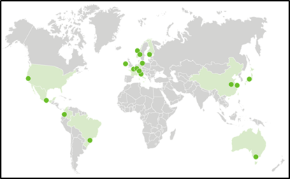
University Partners
Integrative assesment (17.08)
Engineering Innovation Evening Science Gallery Friday 10th April, 2015

Slide 32
Cultural change
‘Inside-out assessment’
Reimagine assessment: our conceptions of what it does, why we do it, who does it, when we do it, and who it is for.
Reposition the assessor and the assessed.
Consider assessment for the outside world.
Intelligence plus character— that’s the goal of true education.
Martin Luther King Jr.

Slide 33
References
Barrie, S. (2004). “A research-based approach to generic graduate attributes policy”. Higher Education Research and Development. 23 (3), 261-275.
Barrie, S. (2007). 'A conceptual framework for the teaching and learning of generic graduate attributes.' Studies in Higher Education, 32.4, pp. 439-458.
Boud, D. (2000). Sustainable assessment: rethinking assessment for the learning society. Studies in Continuing Education, 22, 2, 151-167.
Boud and Falchikov (2006). Aligning assessment with long-term learning. Assessment & Evaluation in Higher Education Vol. 31, No. 4, , pp. 399–413

Slide 34
Bowden, J., Hart, G., King, B., Trigwell, K., & Watts, O. (2000) Generic capabilities of ATN university graduates, Canberra: Australian Government Department of Education, Training and Youth Affairs
de la Harpe, B., & David, C. (2012). Major influences on the teaching and assessment of graduate attributes. Higher Education Research & Development, 31, 493–510.
Knight, P. (2007) Fostering and Assessing Wicked Attributes: Open University: http://www.open.ac.uk/opencetl/sites/www.open.ac.uk.opencetl/files/files/ecms/web-content/Knight-(2007)-Fostering-and-assessing-wicked-competences.pdf [last accessed 21 Octover 2016]

Slide 35
Thank You

